Slide 1
Silent Jarvis - The Behaviour Analyzer
Team: Kalyan Gandhapu (BVCOE, Delhi) &
Sudarshan Paul (KITS, Tamil Nadu)
Mentors: Nithilaksh Lokesh, Priya Upadhyay,
Varun Sharma & Vaishali Sadaphal
Date: 30-06-2021

Slide 2
Examples
Example 1 : Startup Growth Phases:
Business Concept/Plan
Team Building
Seed Financing
Business Development
Branding
1
2
3
4
5
Example 2 : Loan Approval Process:
Receive Loan Application
Review Application
Approval of Loan
Customer signs paperwork
Disperse Fund
1
2
3
No
4
5
Rejected
Our Use Case: Opportunity Sales Data:
Prospecting
RFI in progress
RFI Submitted
Shelved
Disqualified
4-11
1
2
3
12
13
Notes:
Both the cases have certain stages.
Stages may or may not be skipped.
Each one has an Initial stage.
Terminating stage - for startup any stage can be an ending stage.
Terminating stage - for loan approval, usually there is a single ending stage.
Entity : Startup - > A single startup company
Entity : Loan -> A single loan applicant
Our aim is to mine and analyse the behavior of such an entity as it progresses the pipeline.

Slide 3
Problem Statement
Objective:
Develop a framework to process historical information of an entity.
Challenge:
To process the semantics, content and sequence of interactions made by an entity.
Utility:
Generate personalized recommendations to enhance experience.
Notes:
Objective
* Process historical information of an entity to mine entity’s behaviour
Challenge
* Process semantics(e.g.?), content(e.g.?), sequence of interactions
Utility
* Generate personalized recommendations (?)
* Enhance user experience (e.g.?)

Slide 4
Description of data of an entity
Opportunity :
Type of activity
Something that is to be sold
Deals move through various stages
An opportunity has a different behavior depending upon :
Which product is being sold
To which customer is it being sold
What is the revenue of the customer
Objective: Mine behaviour of an opportunity :
How much time does an opportunity spend in a stage
In which stage does an opportunity drop out
Does it get converted into win or loss
Sales Stages
01 - Prospecting
02 - RFI in progress
03 - RFI Submitted
04 - RFP in progress
05 - RFP Submitted
06 - Short Listed
07 - Selected
08 - Contract Negotiation
09 - Closed/WON
10 - Lost
11 - Scrapped
12 - Shelved
13 -Disqualified
Notes:
What is opportunity?
Clients exchange monetary benefits in exchange of some services from an organisation.

Slide 5
Data Overview
Name | Description
ID | Unique opportunity ID
Stage | Opportunity Curren Stage
Name | Opportunity Name
Client_Revenue | Revenue Client is generating from this Opportunity
Region | Operating region
Client_Domain | Domain of the Client
Existing_Customer | Previous client/customer or not
TCS_Revenue | Revenue TCS is generating from this Opportunity
TCS_Domain | Domain of TCS
Time Stamp | Current Stage Transition Date

Slide 6
Workflow
Generate Opportunity Data
Opportunity Success/Failure Prediction
Risk Analysis
Generated synthetic data (since real data is sensitive) based on properties of real data.
Predict success/failure based on behaviour mining:
(i) Feature engineering: RFM
(ii) Built two types of models to predict success/failure.
Proposed a way to classify opportunities based on RFM features and classify opportunities into high, mid, low alert segments.

Slide 7
Methodologies
Refining the Model
5
5
Training and Evaluation
4
4
ML Model Selection
3
Feature Engineering
2
Data Generation
1

Slide 8
Data Modeling
Implemented Markov based model to generate the data.
The company’s revenue is generated by varying the probability considering the region and domain of the client.
0.6
S9
Success Stage
0.45
S4
0.50
S6
0.4
0.3
S2
0.4
0.60
0.70
0.78
S8
S10
0.7
0.26
S1
S3
S5
S7
0.31
0.16
S11
0.21
S13
S12
Closed Stages
Pre Stages
Fig 1: Example State Transition

Slide 9
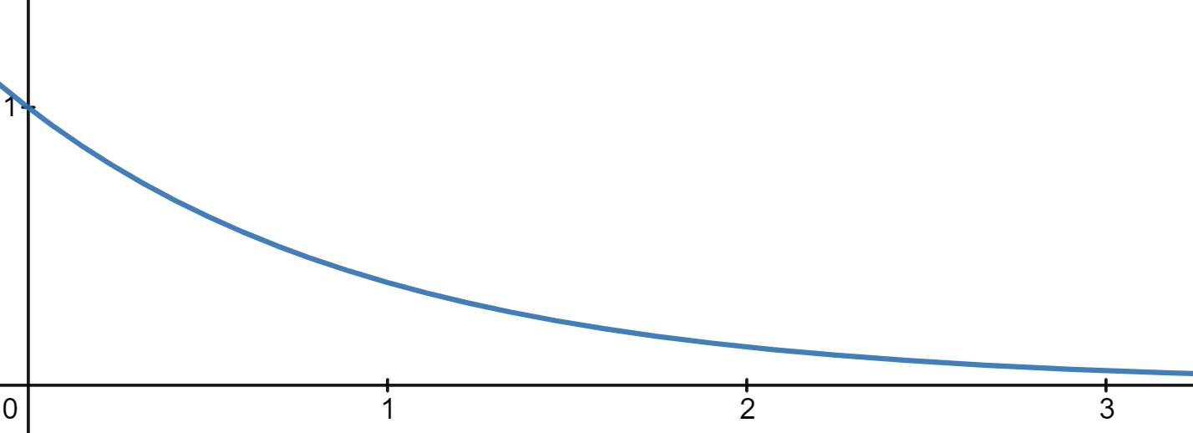
Initially for every opportunity we assigned stage 1.
Next Stage is created by making an assumption that the probability of particular opportunity going to next stage decreases as the number of days increases (follows negative exponential function).
Possible state transitions
Transition Probability
P(x) = e^-t
X1 - Current Stage
X2 - Transit to Next Stage
X3 - Fail on this Stage
Days
Fig 3: State Transitions
Fig 2: Transition Probability vs Days
Notes:
Every opportunity starts in stage1
probability of an opportunity going to next stage decreases as the number of days increases

Slide 10
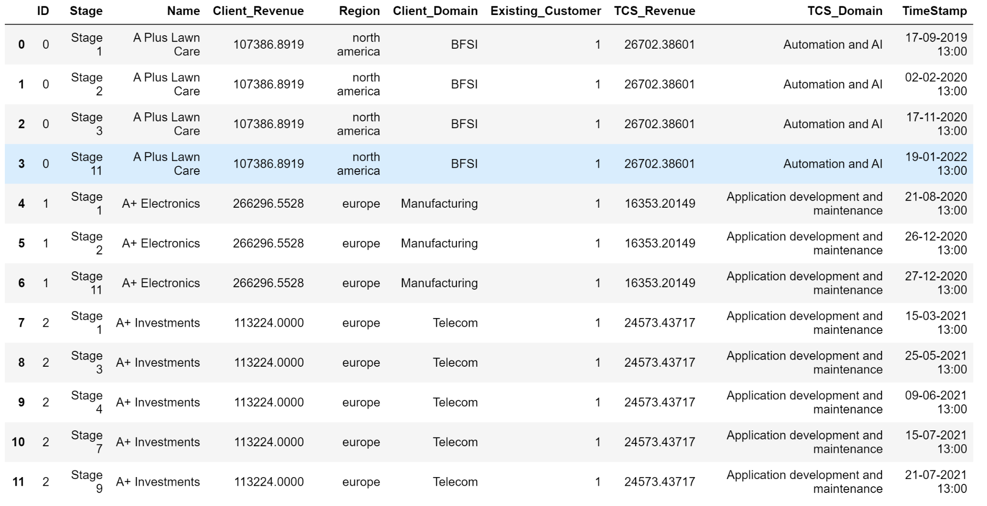
Fig 4: Generated Dataset

Slide 11



Feature Engineering: RFM Metrics
The freshness of customer activity. e.g. time since last activity
The frequency of Customer transactions. E.g. the total number of recorded transactions
The willingness to spend. e.g. the total transaction value
Notes:
Why these features? - RFM
Do you think the behaviour is dependent on these features?
What is frequency? What is one transaction? One stage? No of transactions for one opportunity?

Slide 12
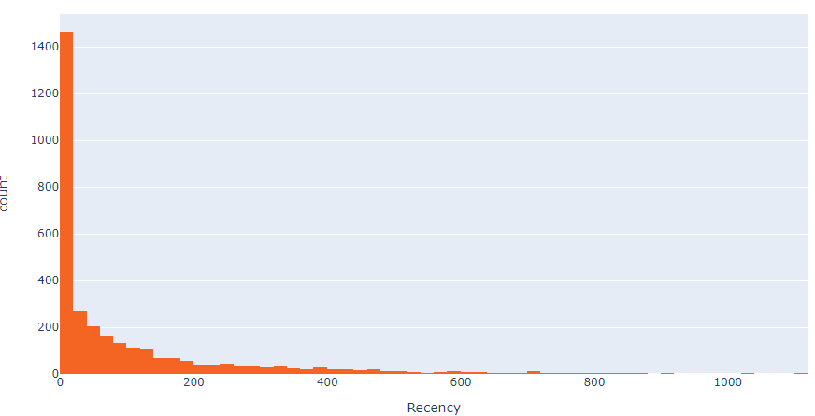
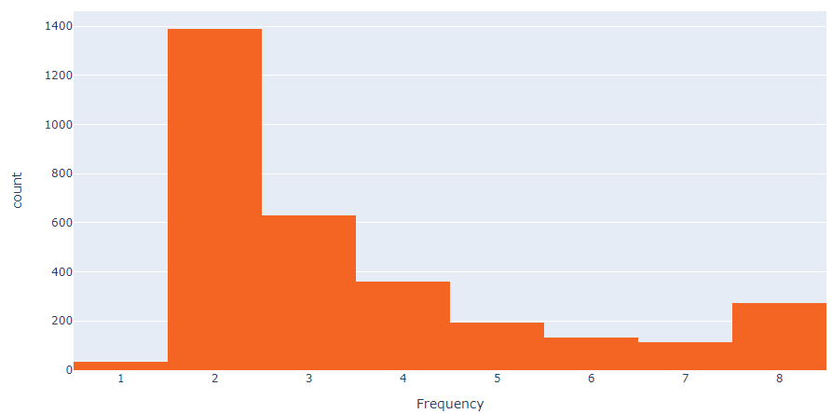
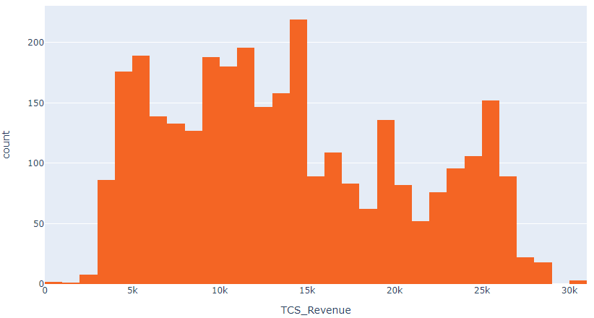
Generation of RFM Attributes
To calculate recency, we need to find out most recent date of opportunity moving to a different stage and see how many days they are inactive for. After having no. of inactive days for each opportunity ID.
To calculate frequency, we need to find total number stages the given opportunity has moved for each opportunity ID.
We consider the monetary value or the revenue for each customer and plot a histogram.
Fig 8: Recency Histogram
Fig 8: Frequency Histogram
Fig 8: Revenue Histogram

Slide 13
Project Success/Failure Prediction
Method 1:
Some best performing modern machine learning algorithms were chosen to predict the outcome (Success/Failure) like MLP-ANN , KNN, SVM, GLMs etc.
In order to prevent overfitting we decided to apply these different predictive supervised algorithms and ensemble them afterwards.
Algorithm | Accuracy | Precision | Recall | F1-Score
SVM | 50% | 42% | 50% | 50%
XGBoost | 83% | 83% | 83% | 83%
Generalized Linear Model | 76% | 77% | 76% | 76%
Gradient Boosting Classifier | 82% | 81% | 82% | 82%
KNN | 75% | 62% | 75% | 75%

Slide 14
Project Success/Failure Prediction
Method 2: Hidden Markov Models (HMMs)
The HMM is an important statistical tool for modelling data with sequential correlations in neighbouring samples.
Improving the accuracy of sequences of predictions by combining regular classifiers and Hidden Markov Models (HMMs).
HMMs are defined by hidden states, state transition probabilities, possible observations and their emission probabilities.
The HMM filter revises the predictions accordingly to their uncertainty and the state transition matrix estimated from data using the Viterbi algorithm.

Slide 15
Project Success/Failure Prediction
Method 2: HMMs
Trained a classifier on training dataset.
Estimated HMM state transition matrix from the dataset.
Estimate class probability distributions for dataset using supervised algorithm.
Predicted most likely sequence of states (i.e stage) for each opportunity in test dataset using HMM filter (13 hidden states were taken).
Algorithm | Accuracy | Precision | Recall | F1-Score
HMM Filter | 88% | 92% | 88% | 89%

Slide 16
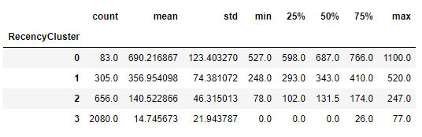
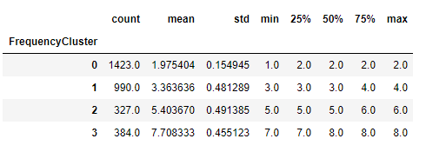
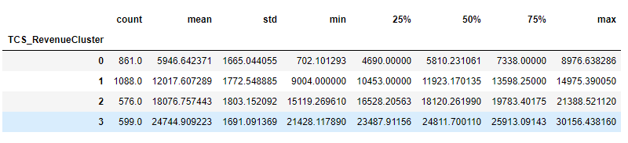
Risk Analysis: RFM Individual Cluster Analysis
Fig 10: Description of RFM Clusters
Notes:
Recency -> greater the cluster number -> Lesser the recency (better the opportunity)
Frequency -> Greater the cluster number -> Greater the frequency (better the opportunity)
Revenue -> Greater the cluster number -> Greater the Revenue (Better the opportunity)

Slide 17
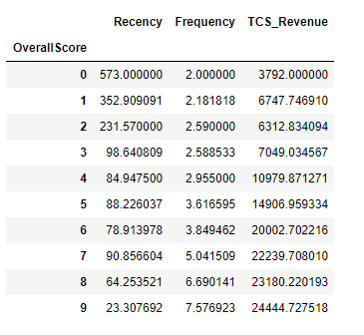

Risk Analysis: RFM Overall Score for Each Opportunity
decreasing
Increasing
Increasing
Worst performing opportunities
HIGH ALERT OPPORTUNITIES
SCORE 0
Highly Inactive
Less Frequent
Less Revenue
MID ALERT OPPORTUNITIES
Good performing opportunities
LOW ALERT OPPORTUNITIES
SCORE 9
Fig 11: Scoring RFM Clusters
Active
Frequent.
More Revenue
Notes:
How is the score computed?
What is its relation with slide15
Where/Why/for what are you going to use this?

Slide 18
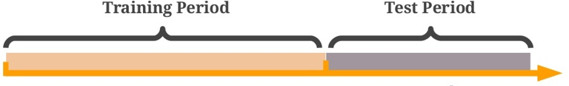
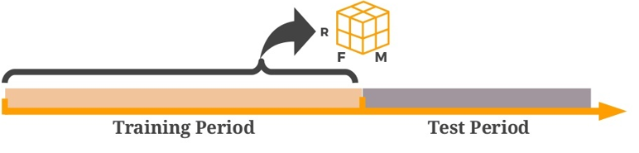
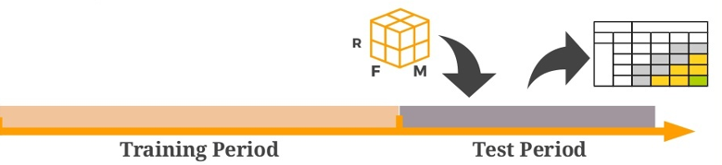
Risk Analysis: Modeling the Classification Approach
1. Splitting Data into Two Parts
Fig 13: Splitting Data
2. Assign customers to RFM Segments using only data from the Training Period
Fig 14: Labelling the Data with RFM segments
3. Training different classification models to predict the opportunity risk label cluster and overall score cluster for each of the input opportunities.
Fig 15: Training model and Predicting labels

Slide 19
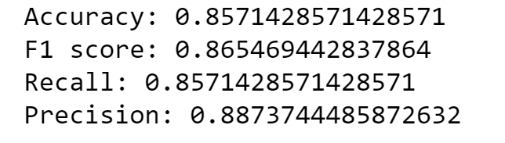
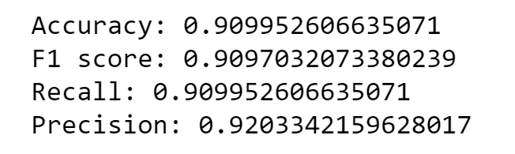
Experiments
Experiment 1: Keeping the stage transition probabilities constant
Variation in data: stages were uniformly distributed across the majority of the opportunities.
Expected result: Model should easily understand the transition between the stages.
Actual result: Model was easily able to predict the next stage.
Metrics:
Experiment 2: Keeping the time taken to transit from one stage to next stage as constant
Variation in data: Time taken to transit from one stage to next stage was observed as nearly constant.
Expected result: Model should be able to learn days taken to move from one stage to another.
Actual result: Model was easily able to predict the next stage.
Metrics:
Notes:
Why this experiment?
What is special about it?
What are you trying to show with it?
Are you saying that you reduced randomess and hence the behaviour improved?

Slide 20
Conclusion
Generated synthetic sales data based on properties of real data.
Performed feature engineering to extract 3 features namely Recency, Frequency, Monetary.
Used various supervised classifiers to predict success/failure of an opportunity.
Used HMM models to show improvement in prediction accuracy.
Proposed use of RFM attributes to perform risk analysis and classify opportunities into high, mid, low alert segments.

Slide 21
What did we learn?
To understand business problem and develop insights on it.
To generate prototype of real data.
To Break down a challenging problem into manageable iterations.
Read and comprehend research papers from different sources relevant to the project needs.

Slide 22
Thank You!

Slide 23
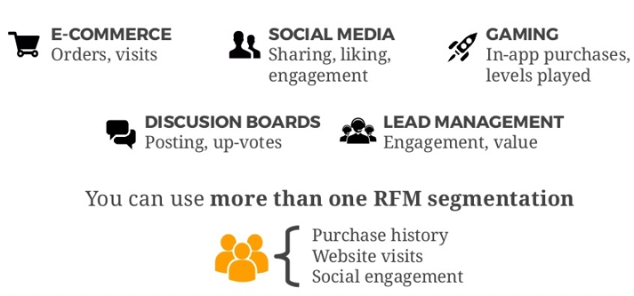
RFM Clustering Use Cases
RFM Segmentation can be applied to activity-related data that has measurable value and is repeatable.
Fig 6: RFM Clustering Applications
Fig 2: Transition Probability vs Days

Slide 24
Viterbi Algorithm
The state space S={ s1 ,s2 ,…..sN } .
The observation space O={ o1 , 02 ,…0K } .
Transition matrix A of size N*N such that Aij stores the transition probability of transiting from state si to sj state.
Emission matrix B of size N*K such that Bij stores the probability of observing oj from state si .
An array of initial probabilities π of size N such that πi stores the probability of state si at time t=1.
Sequence of observations y1 ,y2…..yT .

Slide 25
